Slide 1
Lecture 6 Controlled Sources (2)
Hung-yi Lee

Slide 2
Outline
Node analysis with Controlled sources
Chapter 4.3
Mesh analysis with Controlled sources
Chapter 4.3
Superposition with Controlled sources
Chapter 2.4

Slide 3
Outline
Node analysis with Controlled sources
Chapter 4.3
Mesh analysis with Controlled sources
Chapter 4.3
Superposition with Controlled sources
Chapter 2.4

Slide 4
Node Analysis - Review
Target: Find node potentials
Steps:
1. Set a node as reference point
2. Find nodes with unknown node potentials
3. KCL for these nodes
Represent unknown current by node potentials

Slide 5
Node Analysis with Controlled Sources
Consider the controlled sources just as independent sources
But with current or voltage as unknown variables
List the equations with node potentials and current or voltage of controlled sources
Represent current or voltage of the controlled sources by node potentials
Can you we that?
Obtain equations only with node potentials

Slide 6
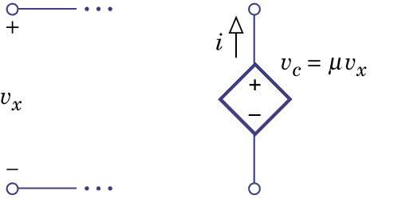
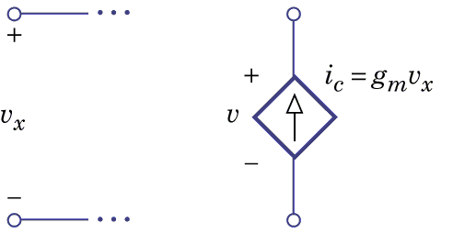
Node Analysis with Controlled Sources
Voltage controlled
Easy to represent control variable v_{x} by node potentials

Slide 7
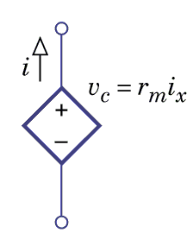
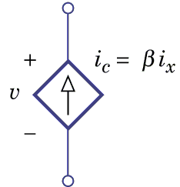
Node Analysis with Controlled Sources
Current controlled
In most cases, we can represent the control variable i_{x} by node potentials (refer to slides of Lecture 2)
Except that when i_{x} is the current of voltage sources

Slide 8
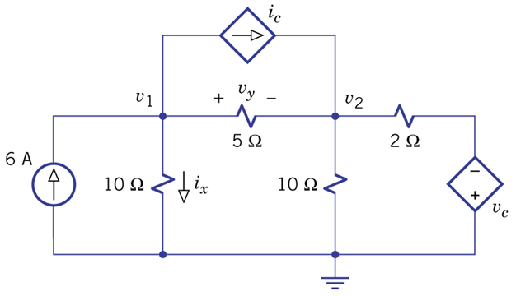
Problem 4.58 – CCCS, VCVS
Node 1:
Node 2:

Slide 9
Outline
Node analysis with Controlled sources
Chapter 4.3
Mesh analysis with Controlled sources
Chapter 4.3
Superposition with Controlled sources
Chapter 2.4

Slide 10
Mesh Analysis - Review
Target: Find mesh current
Steps:
KVL for each mesh
Represent the voltage of the elements by mesh current
With controlled sources
Represent the current or voltage of the controlled sources by mesh currents

Slide 11
Mesh Analysis with Controlled Sources
Current controlled
Easy to represent control variable i_{x} by mesh currents

Slide 12
Mesh Analysis with Controlled Sources
Voltage controlled
In most cases, we can represent the control variable v_{x} by mesh currents (refer to slides of Lecture 3)
Except that when v_{x} is the voltage of current sources

Slide 13
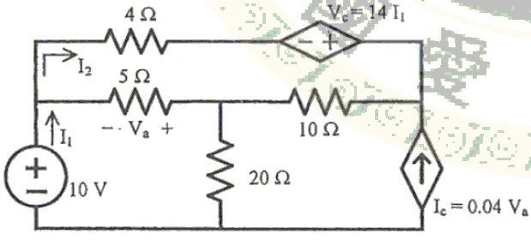
台大碩士入學 (2012) – CCVS, VCCS
+
-
-
+
+
-
Mesh 1:
Mesh 2:
Notes:
How about node analysis?

Slide 14
Outline
Controlled sources
Chapter 2.3, 3.2
Node analysis with Controlled sources
Chapter 4.3
Mesh analysis with Controlled sources
Chapter 4.3
Superposition with Controlled sources
Chapter 2.4

Slide 15
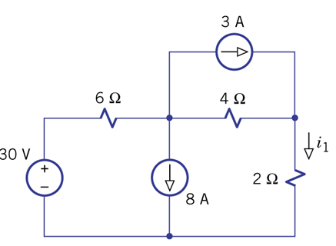
Superposition Principle
Example 2.10
Find i₁
We can find i₁₋₁, i₁₋₂, i₁₋₃ separately.
set x₂=0 and x₃=0
find
set x₁=0 and x₃=0
find
set x₁=0 and x₂=0
find

Slide 16
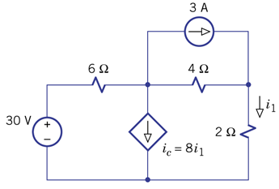
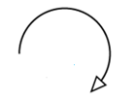
Superposition Principle with controlled variable
Example 2.11
Find i₁
+
-
+
-
+
-

Slide 17
Superposition Principle with controlled variable
Example 2.11
Find i₁
set x₂=0
The current through 2Ω is i₁₋₁.
set x₁=0
The current through 2Ω is i₁₋₂.
Do not “turn off” controlled sources

Slide 18
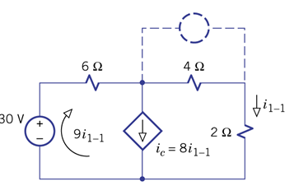
Superposition Principle with controlled variable
Example 2.11
Find i₁
+
-
+
-
+
-
set x₂=0
Open circuit
KVL for the big loop:

Slide 19
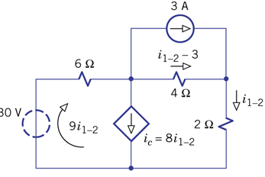
Superposition Principle with controlled variable
Example 2.11
Find i₁
+
-
+
-
+
-
set x₁=0
short circuit
KVL for the big loop:

Slide 20
Superposition Principle with controlled variable
Example 2.11
Find i₁
set x₂=0
The current through 2Ω is i₁₋₁.
set x₁=0
The current through 2Ω is i₁₋₂.

Slide 21
Superposition Principle with controlled variable
Example 2.11
Find i₁
Can we use superposition in this way?

Slide 22
Homework
Node analysis with Controlled sources
4.56

Slide 23
Homework
Mesh analysis with Controlled sources
4.50
4.51

Slide 24
Homework
Superposition with Controlled sources

Slide 25
Thank you!

Slide 26
Answer
Node analysis with Controlled sources
4.56: v1=8V, v2=8V

Slide 27
Answer
Mesh analysis with Controlled sources
4.50: i1=-2mA, i2=0
4.51: (a) i1=0, i2=-3 (b) v1=12, v2=60, Req=infinity

Slide 28
Answer
Superposition with Controlled sources

